Slide 1
Maharashtra Institute of Technology, Aurangabad. Department of Computer Science and Engineering (2022-23 Part-I) Major Project Review - 1 Flower Detection and Classification
Group Member: Guided by:
1)Ganesh Jamkar (59) Ms. D.R. Deshmukh
2)Arbaz Khan (54)
3)Amit Potdar (58)

Slide 2
Course Outcomes:
CO 1: Formulate problem statement based on real world problem.
CO 2: Analyze the collected system requirements.
CO 3: Apply suitable design methodology.
CO 4: Work efficiently in a team.
CO 5: Plan and organize the work by following project management techniques.
CO 6 :Effectively communicate technical information in presentation and writing by adhering to ethical principles.

Slide 3
Introduction:
1.Now a day’s it is very important to identify naturally occurring objects and recognize its type.
2.It is useful to identify flower type in various fields such as Gardening, botany research, Ayurvedically treatment, Farming, floriculture etc.
3.Our literature survey must find that the different Image processing techniques used to extract features from flower and classify them using computational intelligence algorithms.
4.Digital image processing deals with manipulation of digital images through a digital computer. Digital image processing technologies such as Classification, Feature extraction, Pattern recognition etc. are useful to classify the images.

Slide 4
Problem statement:
Given a photograph of a flower, the aim is to identify the type of the flower using machine learning and to display its relevant information.
)

Slide 5
Literature survey
[1] Automated Flower Species Detection and Recognition from Digital Images, 2017 -> Aalaa Albadarneh and Ashraf Ahmad
[2] Flower Recognition System Based on Image Processing,2014 -> Tanakorn Tiay, Pipimphorn Benyaphaichit, and Panomkhawn Riyamongkol
[3] Flower Detection and Counting Using Morphological and
Segmentation Technique,2015 -> Balvant V. Biradar, Santosh P. Shrikhande

Slide 6
Feature Detection and Extraction
1) The flower recognition system based on image processing has been developed. This system uses edge and color characteristics of flower images to classify flowers.
2)Feature extraction helps to reduce the amount of redundant data from the data set.
3)The image is then cropped automatically by searching for the top, bottom, left, and right most extents of the flower position which are used to cut out the background of image.
1)Detect Features
2)Extract Features
3)Match Features
4)Image Retrieval
5)Visualization and Display
6)Store Features
7)Transform Objects
8)Retrieve Images
.

Slide 7
Proposed system
IMAGE DATABASE
FEATURE
EXTRACTION
FEATURE
SELECTION
MACHINE LEARNING
(train/test)
CLASSIFICATION
PERFORMANCE
EVALUATION
Notes:
The proposed system
Image Dataset
Feature Extraction
Feature Selection
Machine Learning( Train/Test)
Classification
Performance Evaluation

Slide 8
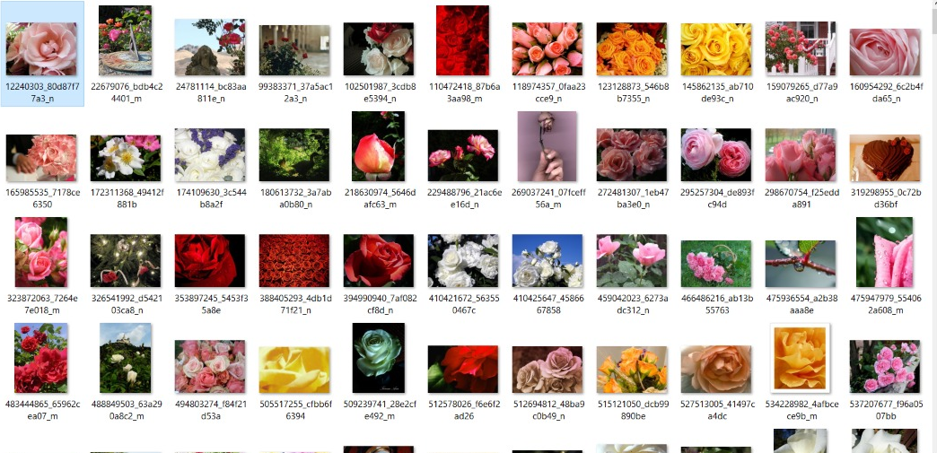
DATASET

Slide 9
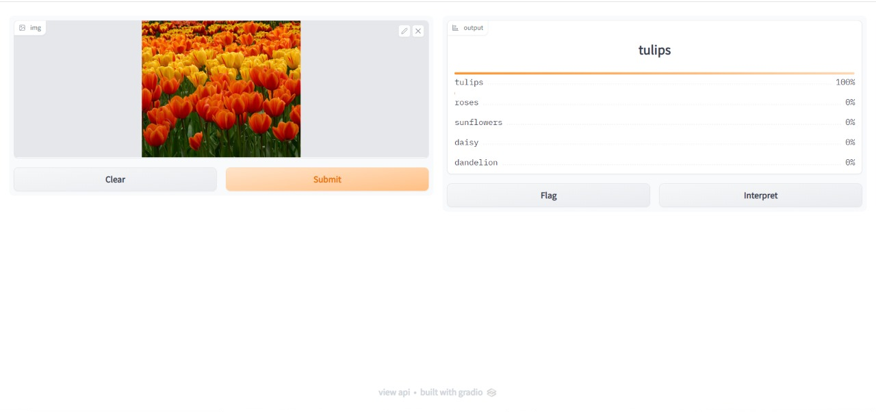

Slide 10
REFERENCES
[1] M. Das, R. Manmatha, and E. M. Riseman, “Indexing flower patent images using domain knowledge”, IEEE Intell. Syst., vol 14, pp. 24-33, 1999.
[2] T. Saitoh and T. Kaneko, “Automatic recognition of wild flowers”, System and Computer in Japan, vol. 34, no. 10, 2003.
[3] M. E. Nilsback , and A. Zisserman, “A visual vocabulary for flower classification”, In CVPR, 2006.
[4] Y. Chai, “Recognition between a large number of flower species”, Master thesis, University of Oxford 2011
[5] https://www.kaggle.com/datasets/alxmamaev/flowers-recognition

Slide 11
Thank You.

